Slide 1
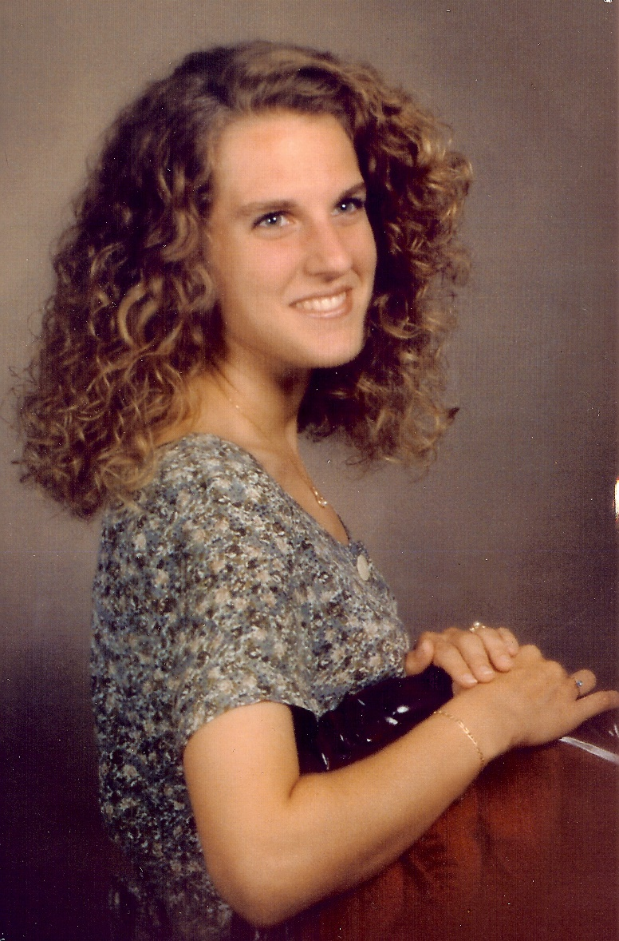
Honoring the Memory of Melissa Pellegrin …
… and the Pursuit of Excellence in Technical Communication

